Slide 1
General ideas to communicate
Dynamic model
Noise
Propagation of uncertainty
Covariance matrices
Correlations and dependencs

Slide 2
Multivariate Statistics and
Propagation of Uncertainty
We will denote mean values by E

Slide 3
How can we generalize/modify the concept of a state for probabilistic systems
State can be a state of measurement, state of control, state of the system, etc.
State is a very general concept.

Slide 4
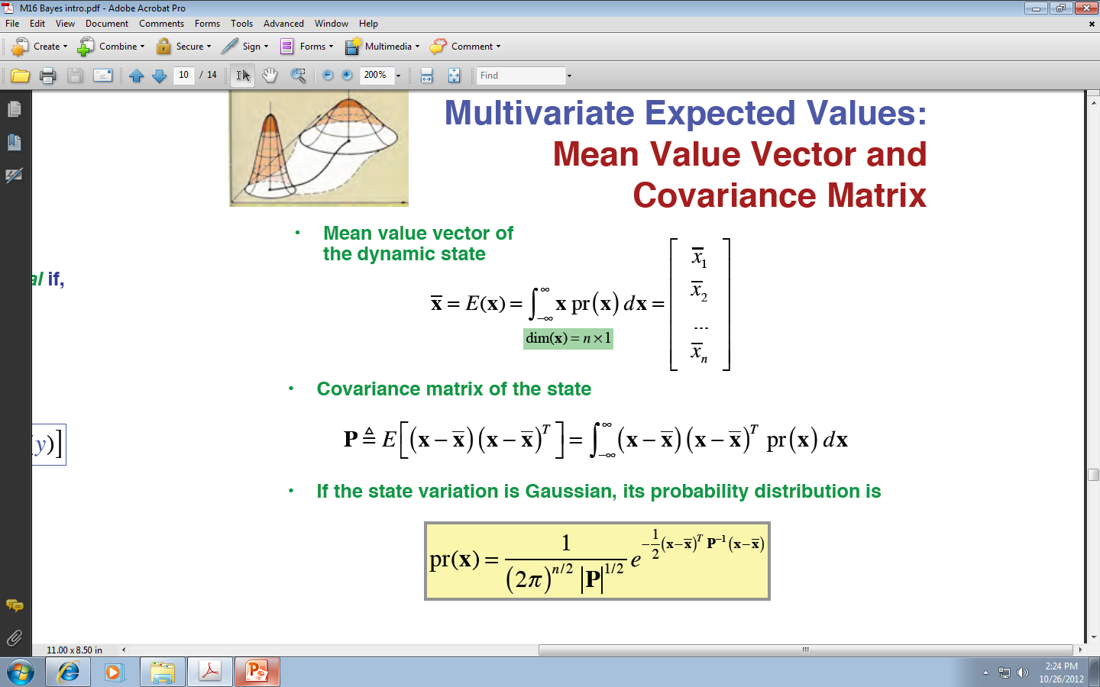
Multivariate Expected Values:
In classical approach state is a vector of values.
In modern approach state is a dynamic state, a vector of expected values
Mean Value Vector
But it is more to this, as the covariances are also important.
This leads to the concept of a MATRIX – Covariance Matrix of a state

Slide 5
Covariance matrix is the most general description of probabilistic state

Slide 6
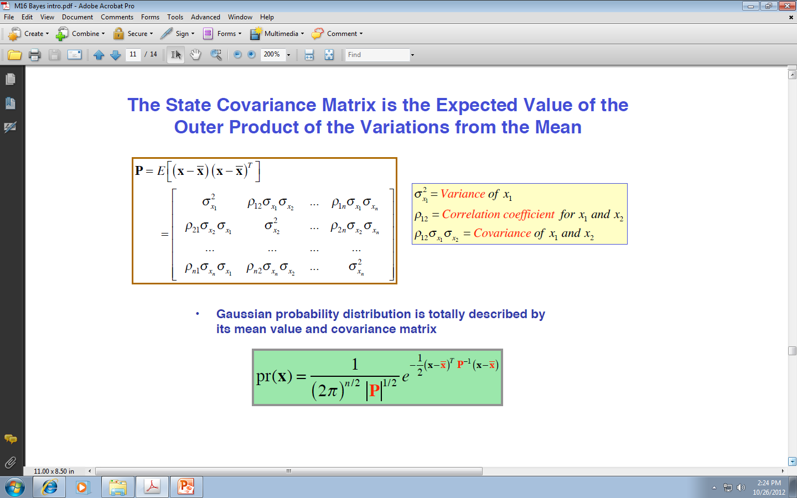
Covariance Matrix of the state
Transposed vector
vector
Outer product of vectors is a matrix

Slide 7
The State Covariance Matrix is the Expected Value of the Outer Product of the Variations from the Mean
Mathematical beauty - Outer Product

Slide 8
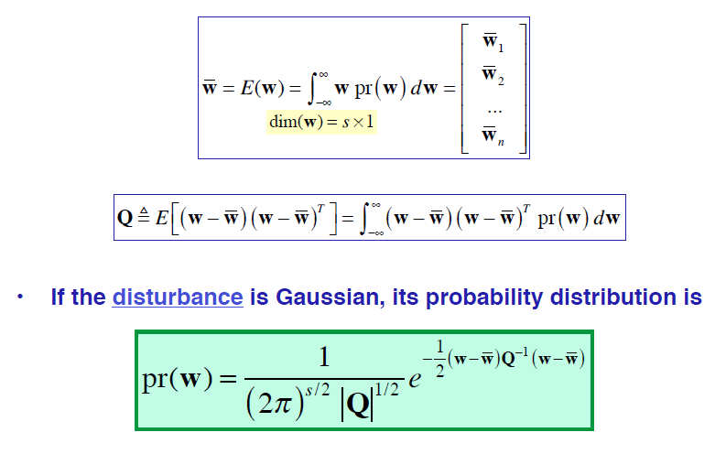
Mean Value and Covariance of the Disturbance
Mean value of the disturbance
Covariance of the disturbance
Probability distribution of Covariance of the disturbance

Slide 9
Stochastic Dynamic Models

Slide 10
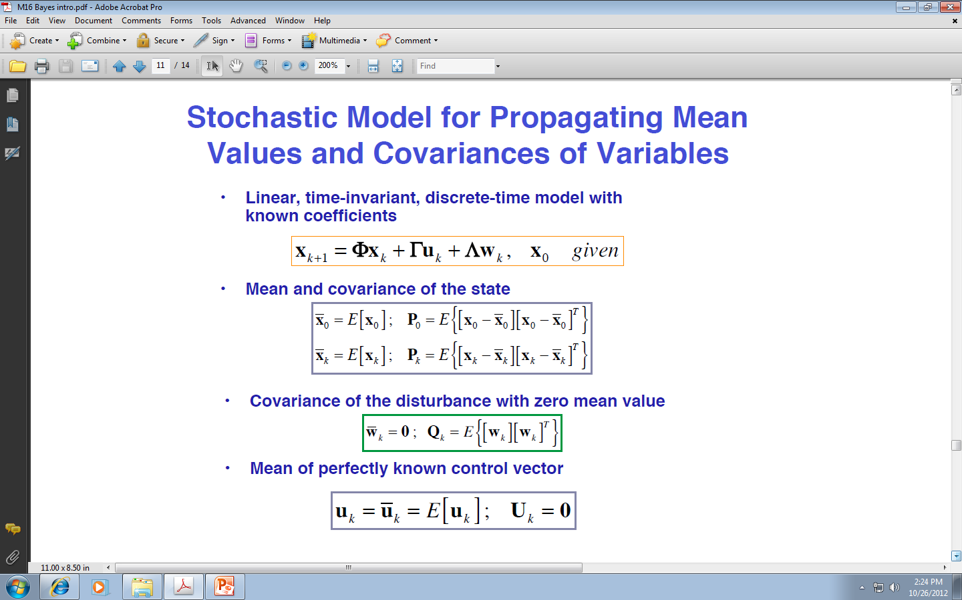
Stochastic Model for Propagating Mean Values and Covariances of Variables
Control
Disturbence or noise
New state
Present state
LTI = Linear Time Invariant System

Slide 11
Stochastic Model for Propagating Mean Values and Covariances of Variables
LTI = Linear Time Invariant System

Slide 12
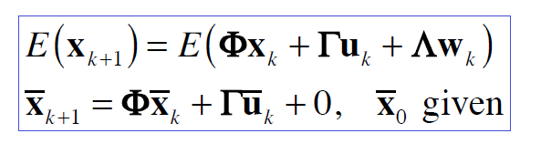
Dynamic Model to Propagate the Mean Value of the State

Slide 13
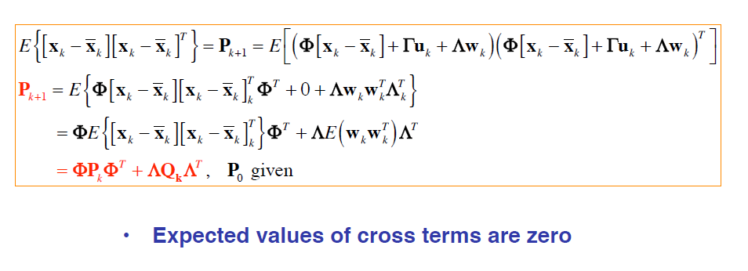
Dynamic Model to Propagate the Covariance of the State
We derive new covariance matrix as a function of old covariance matrix
Old covariance
New covariance

Slide 14
How the state is propagated through the dynamic system?
How the probability density function of the state is propagated?

Slide 15
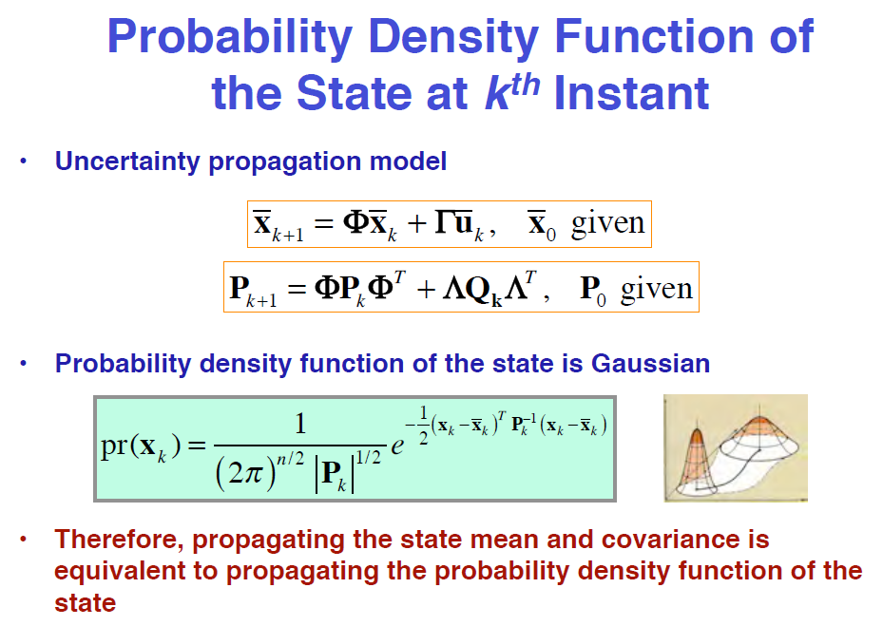
State k
State k+1
Propagation of covariance

Slide 16
What can be a relation between two random variables?

Slide 17
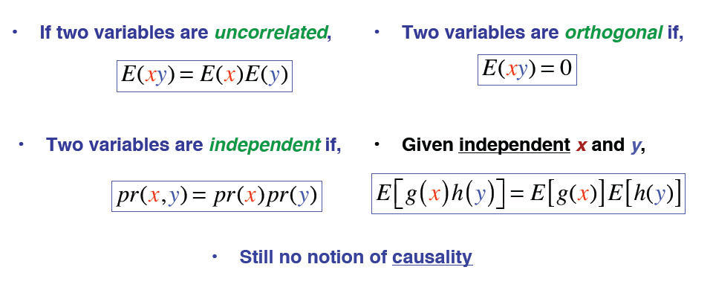
Correlation, Orthogonality and Dependence of Two Random Variables
We denote mean values by E

Slide 18
Correlation and Independence of random variables

Slide 19
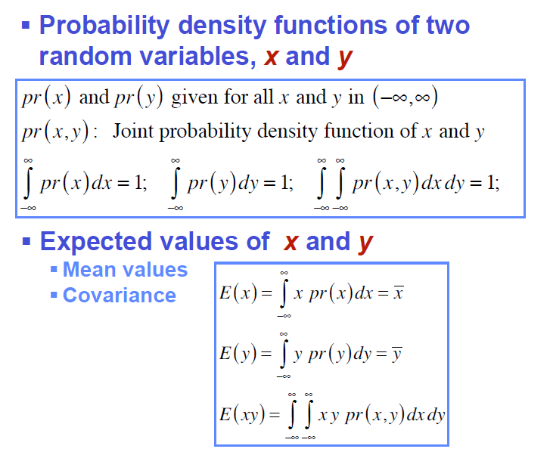
Correlation and Independence

Slide 20
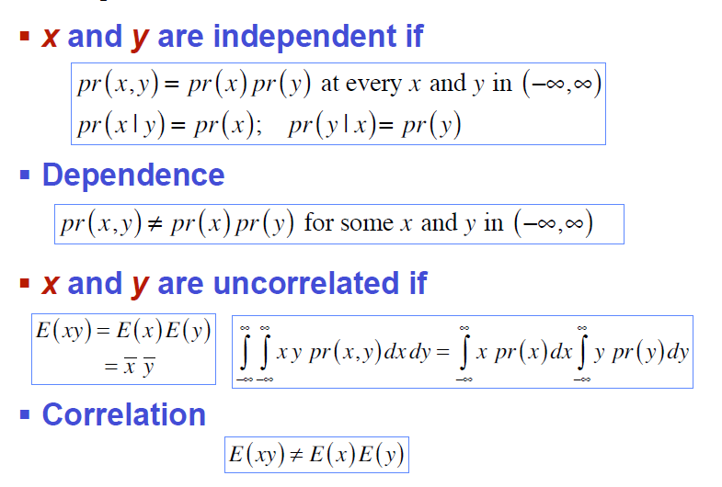
Independence and Correlation

Slide 21
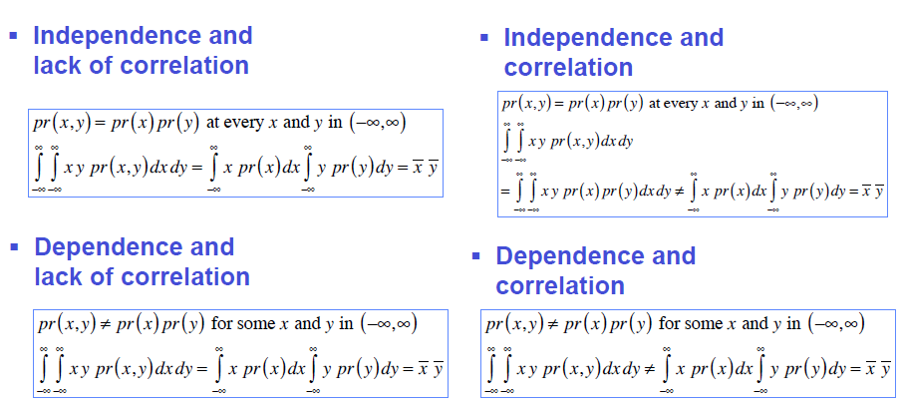
Which Combinations are Possible?
Correlation, lack of correlations,
dependence, independence

Slide 22
Example of what combinations are possible

Slide 23
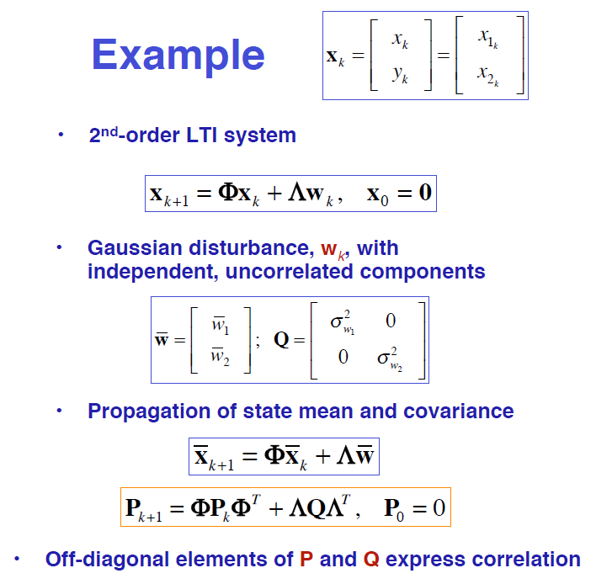
Example of what combinations are possible
Linear Time Invariant

Slide 24
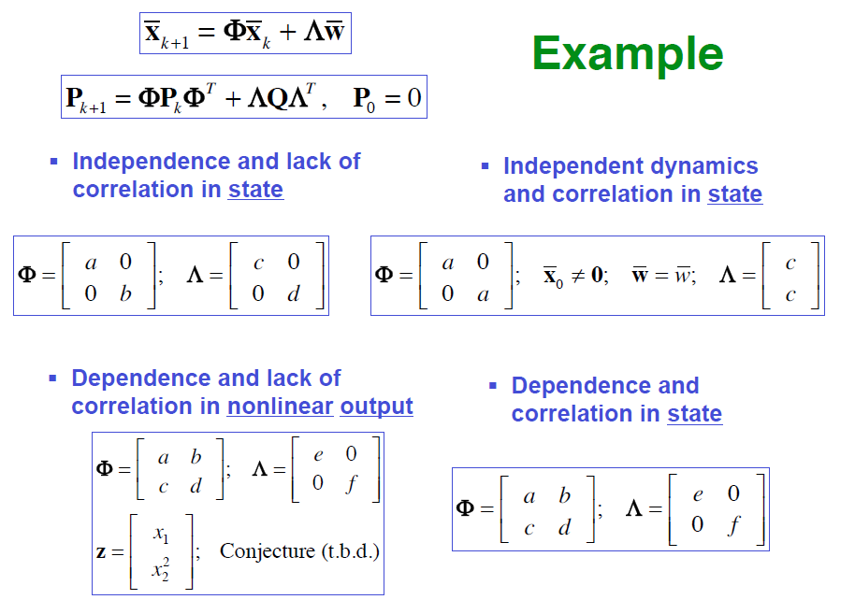
From last slide
Example Continued

